Slide 1


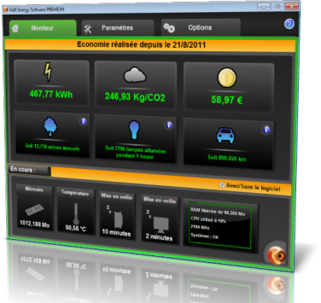
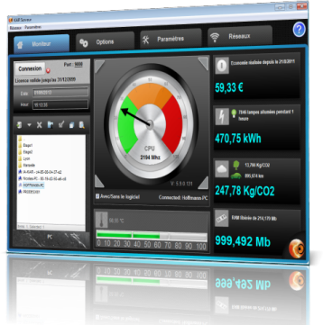

KAR Energy Software
http://www.ia-kar.com

Slide 2








Introduction
Make significant savings on three different levels:
Energy saving: less spending
Save time: more efficiency at the workplace
Material: extends the life of computer equipment
100% software solution
Simple, automatic, transparent
And without equipment replacement!

Slide 3

Facts
Result
- The production of a desktop computer is estimated at 600kg of CO2 and 675kg for a flat screen.
- A desktop computer consumes 65W/H 130W/H when it is on and if it is on 24/24, then it consumes 500 kWh to 1300 kWh per year.
- Between 2000 and 2005, consumption of large electrical data centers has doubled. If we follow this way, in 25 years, the energy consumption will be
the virtual equivalent to that of the world today!
This can raise the spending costs of electricity by 90$ per year and 250Kg/CO2!

Slide 4

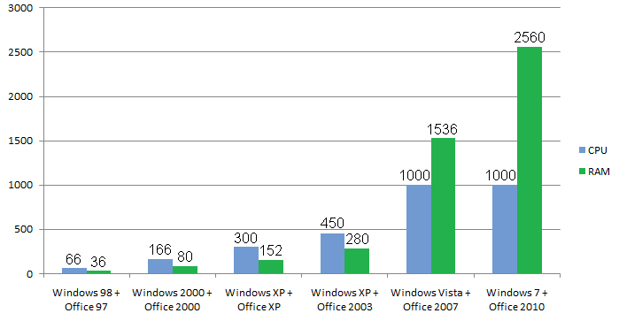
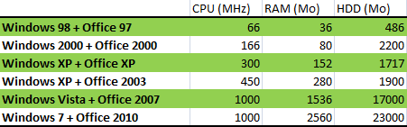

Facts
Year after year, new software versions still require more resources (memory, CPU, disk, graphics card, etc.). To make the same tasks.

Slide 5




Facts
Result
Over 57% of users say they never turn off their PCs.
Why?
Reboot is too long.
- For some of them, the constant switching on and off damage
the PCs.
The screen saver is a big energy consumer.

Slide 6






Over 48% increase on the carbon footprint
and the electricity bill for your PC

Slide 7







Profits
Rapid return on investment
48% consumption reduction
Accelerates the performance of your computer
Increases battery life
Extends life of equipment with automation
Lowers the temperature of your processor
Reduces the startup time of your PC

Slide 8
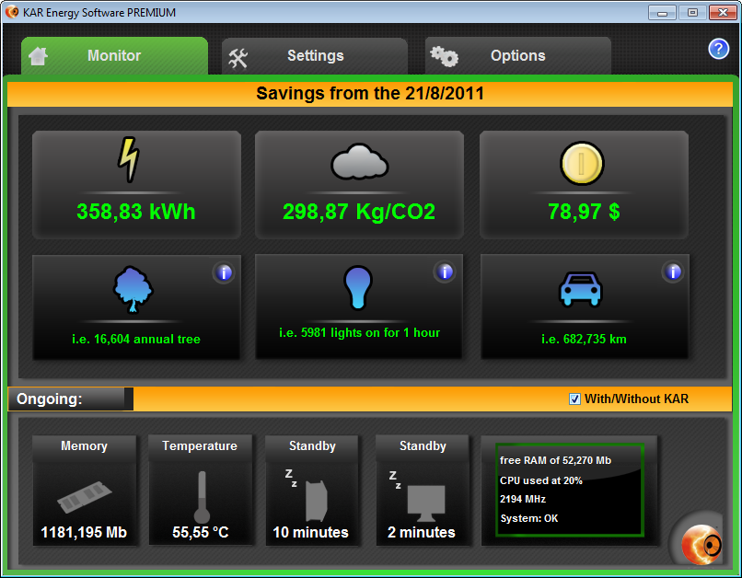

Manage consumption
A complete interface
Explanatory
Animated
Manageable

Slide 9
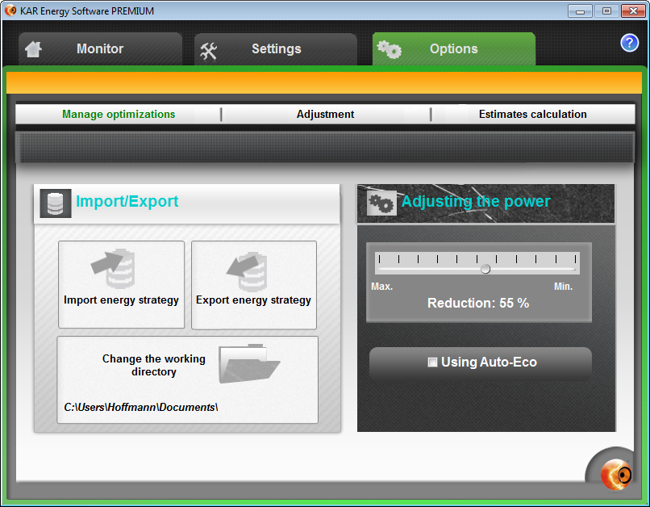
Manage consumption
It regulates the power of your PC
Simple
Automatic
Transparent

Slide 10
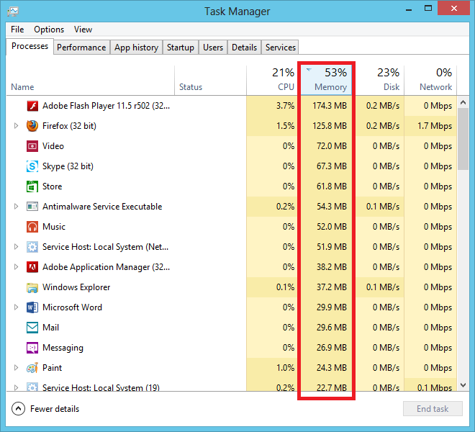
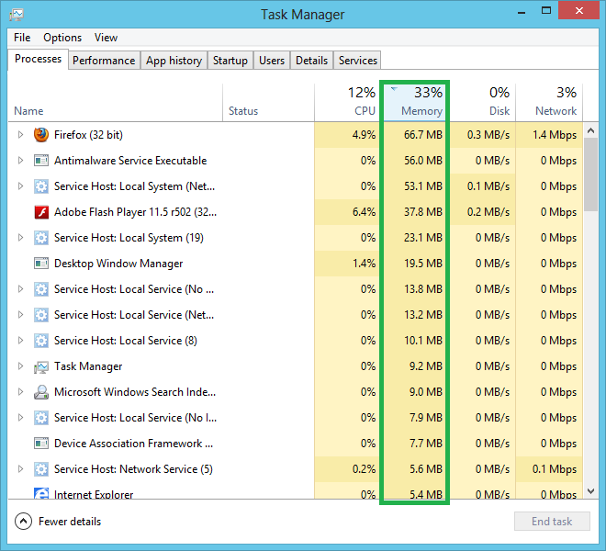
Manage consumption
It adapts the RAM on your PC
Acceleration system
Less overheating
More stability
5 times faster!

Slide 11
Manage consumption
It cools the processor
Test on Intel Celeron 900
55°C
45°C
Extended computer life
Less consumption
Extend battery life

Slide 12


Manage consumption
Wake Up on StandBy
No waste
Ready to work
Save time
Wake On Timer / Wake On LAN

Slide 13

Light intensity management for laptops
Extends battery life
Always on
Powerful

Slide 14
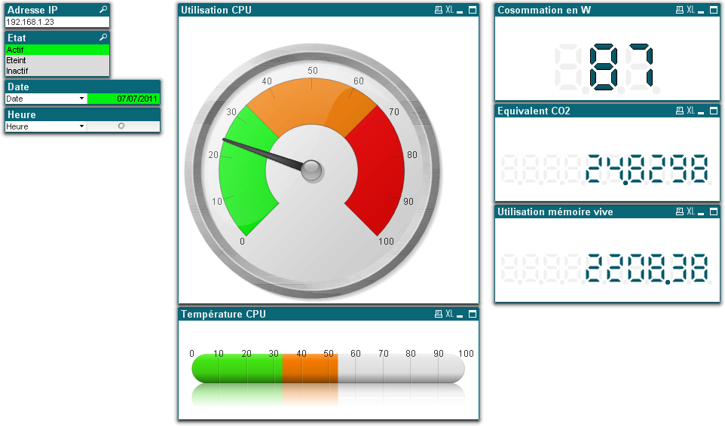
Result
Power automatically adjusted according to user needs
RAM handled automatically
CPU cooling automatically increasing the lifespan of the computer
A fully automated software!

Slide 15
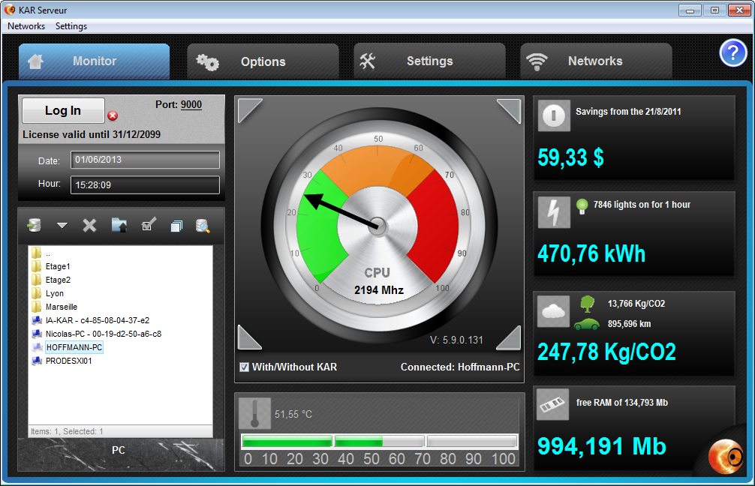
Control panel
Control panel with KAR Serveur
Set energy strategies

Slide 16
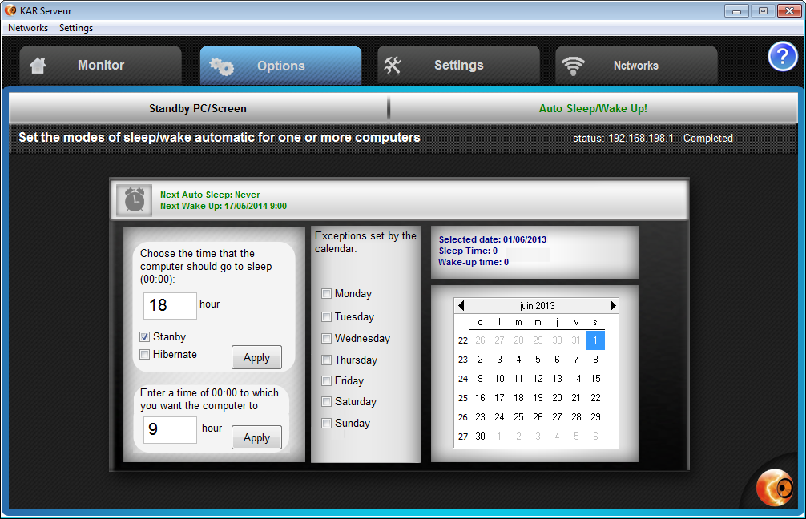
Control panel
Set the days and exceptions
Calendars management

Slide 17

Comparison and R.O.I.
Cost to a company with 1,500 computers over 3 years
 | WITHOUT KAR ECO | WITH KAR ECO | ROI
Average cost per KW / H (Allow an increase every 6 months from 3% to 6%) | 0,0953 € NO VAT | 0,0953 € NO VAT
Electricity consumption | 2 897 532,00 kWh | 1 680 568,56 kWh | 1 216 963,44 kWh
Cost over 3 years | 276 134,79 € NO VAT | 160 158,18 € NO VAT | 115 976,61 € NO VAT
CO2 emissions over a year (or 1 KW / H = 130 GCO2) | 376,68 Tonnes | 218,46 Tonnes | 158,22 Tonnes
Extends the life of computers | Renewal every 3 years | Renewal every 6 years | 3 years extented
Initial data
ROI is equivalent to:
1 054 800 Km
45 Go/Return
Paris-New York
8 790 Trees

Slide 18

Spending
Summary of energy spending
57% of computers never switch off
Consumption is not suited to actual use
Overconsumption of energy on the electrical expense

Slide 19
Evolution
With KAR Energy Software, it’s only profit for you!
15 MB hard disk free space
Installation in less than 7 seconds
Not need to reboot

Slide 20
IA-KAR
KAR Energy Software was the winner of numerous competitions:
- Youth Challenge Competitions (2009)
- European Innovative Company Competitions (2009)
- Talents Competitions (2010)
- Startup Grand Prix (2010)
- Challenge for Young Inventors and Creators in Monts with Concours Lépine Gold Medal (2011)
- Business Creation Competition Eco-Citizen (2011)
- Crédit Agricole
- Association d'EGEE d'Orléans
- Crédit Mutuel
- Technopôle de Montpellier
KAR Energy Software is also supported by:

Slide 21




Partners

Slide 22


Contact
Alexander Hoffmann
Director
+33 (0)6 11 30 11 61
alexander.hoffmann@ia-kar.com
SAVEE
20 rue famille Carrausse
34300 AGDE – France
https://www.ia-kar.com

