Slide 1
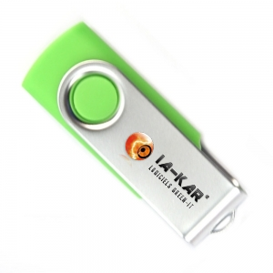
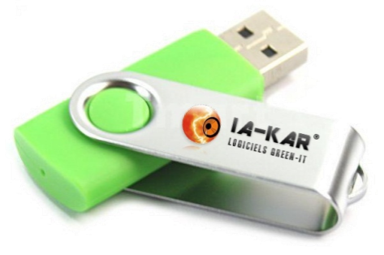
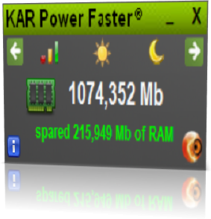
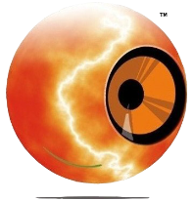
KAR Power Faster
http://www.ia-kar.com

Slide 2
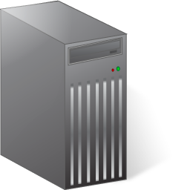
Introduction
3 things to optimize your computer:
Energy: extend battery life
Save time: more efficiency at the workplace
Material: extends the life of computer equipment
100% software solution
Simple, automatic, transparent
And without equipment replacement!

Slide 3
The benefits
Increases battery life
Accelerates the performance of your computer
Extends life of equipment
Lowers the temperature of your processor
Without the reboot time of your PC
Reduce the startup time of your PC
Best energy strategy

Slide 4
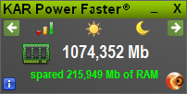
KAR Power Faster
A simple small widget that does it all!
Explanatory
Animated
Manageable

Slide 5
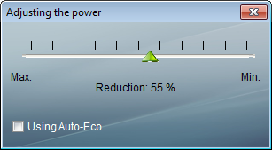
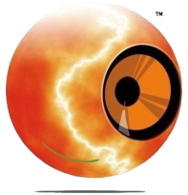
KAR Power Faster
It regulates the power of your PC
Simple
Automatic
Transparent

Slide 6
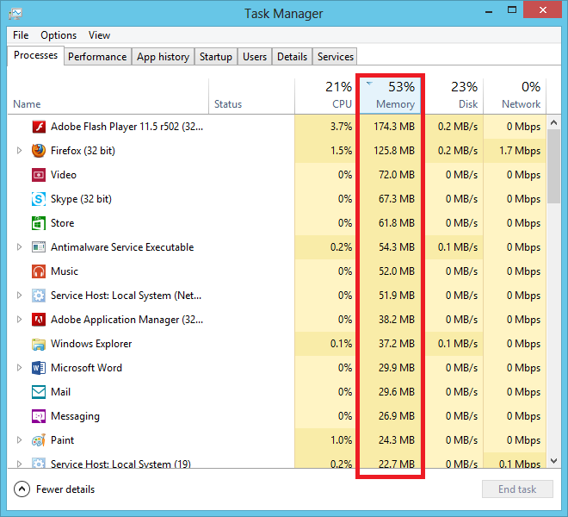
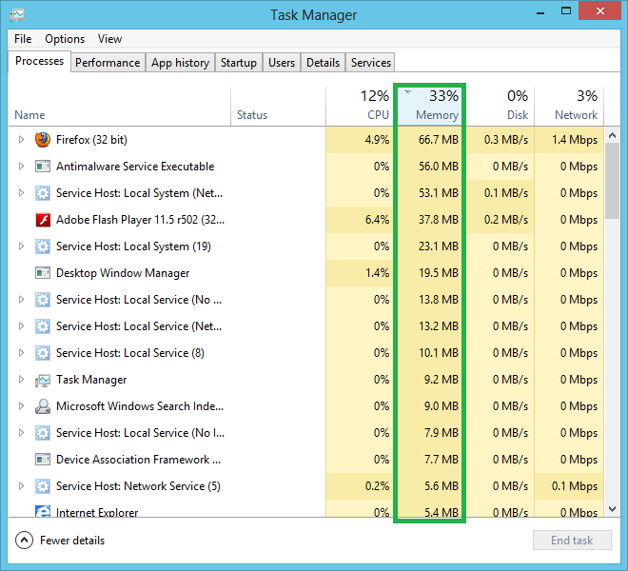
KAR Power Faster
It adapts the RAM on your PC
Acceleration system
Less overheating
More stability
5 times faster!

Slide 7
KAR Power Faster
It cools the processor
Test on Intel Celeron 900
55°C
45°C
Extended computer life
Less consumption
Extend battery life

Slide 8
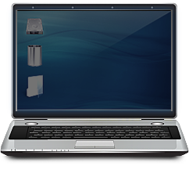
KAR Power Faster
Light intensity management for laptops
Extends battery life
Always on
Powerful

Slide 9
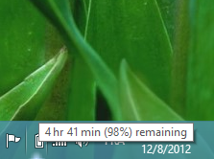
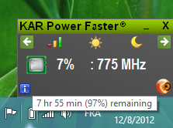
Result
A computer much more stable with much longer battery life and a long life!
Life is extended!
The battery life is 2 times more important!

Slide 10
Evolution
With KAR Power Faster, it’s only profit for you!
15 MB hard disk free space
Installation in less than 7 seconds
Not need to reboot

Slide 11
IA-KAR
KAR Power Faster was the winner of numerous competitions:
- Youth Challenge Competitions (2009)
- European Innovative Company Competitions (2009)
- Talents Competitions (2010)
- Startup Grand Prix (2010)
- Challenge for Young Inventors and Creators in Monts with Concours Lépine Gold Medal (2011) - Business Creation Competition Eco-Citizen (2011)
- Crédit Agricole
- Association d'EGEE d'Orléans
- Crédit Mutuel
- Technopôle de Montpellier
KAR Power Faster is also supported by:

Slide 12
Partners

Slide 13
Contact
Alexander Hoffmann Directeur
+33 (0)6 11 30 11 61
alexander.hoffmann@ia-kar.com
SAVEE
20 rue famille Carrausse 34300 AGDE – France https://www.ia-kar.com

